Slide 1
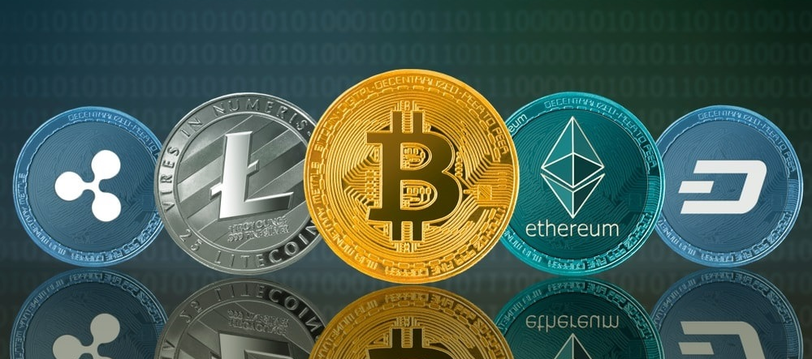
Portfolio Optimization– Crypto Currency
Shinan

Slide 2
Crypto currency – Digital asset for illustration purpose only
Gold vs Bitcoin (digital gold per say)
1 ounce of gold ≈ 0,031kg
Is it possible to carry 1 Trillion Dollar (1 ounce ≈1.770$ as of 17.02.21 )?
NONO 1 T$ ≈17,514,124 kg gold
YES 1 wallet BTC address which is just a line of hash code.

Slide 3
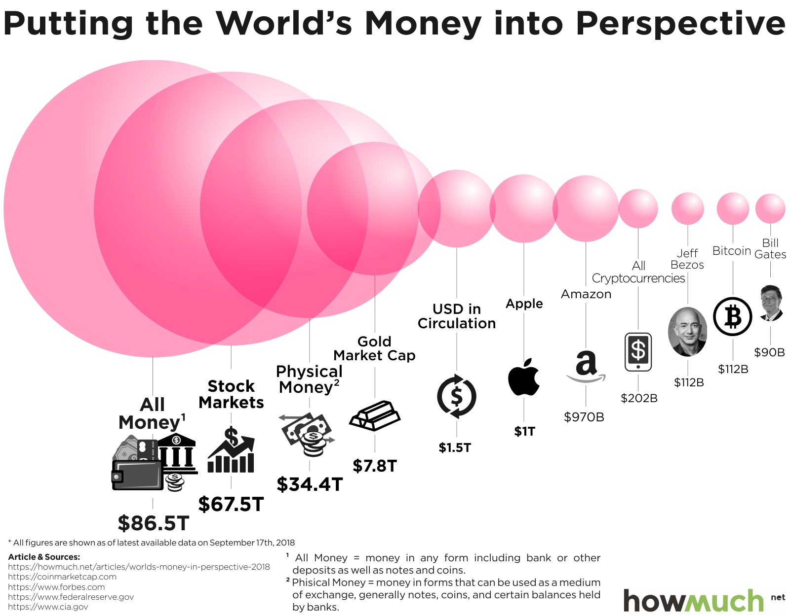
Why I think it has potential?
For illustration purpose only

Slide 4
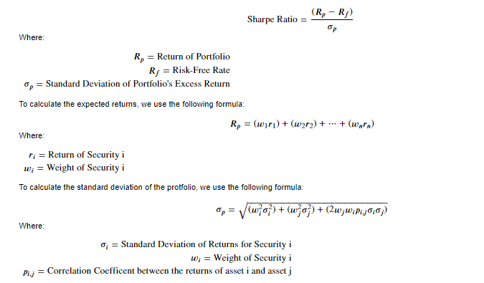
Applying Monte Carlo Simulation to optimize the portfolio
Data : downloaded from Coingecko API
01.01.19 to 31.12.19 for 10 crypto currencies with the highest market cap
2. Used metrics: return, volatility (std), Sharpe ratio which are standard measurements on the traditional assets class such as for stocks.

Slide 5
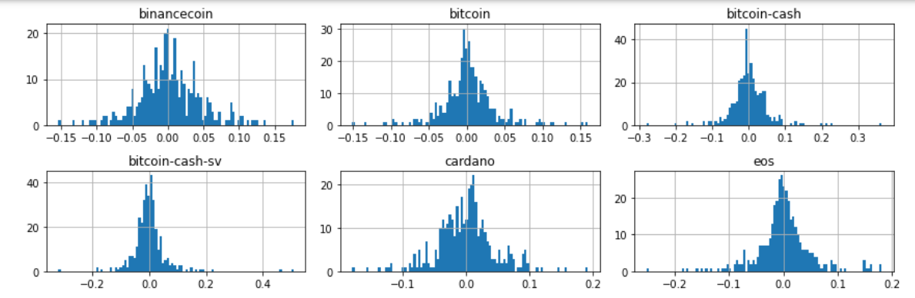
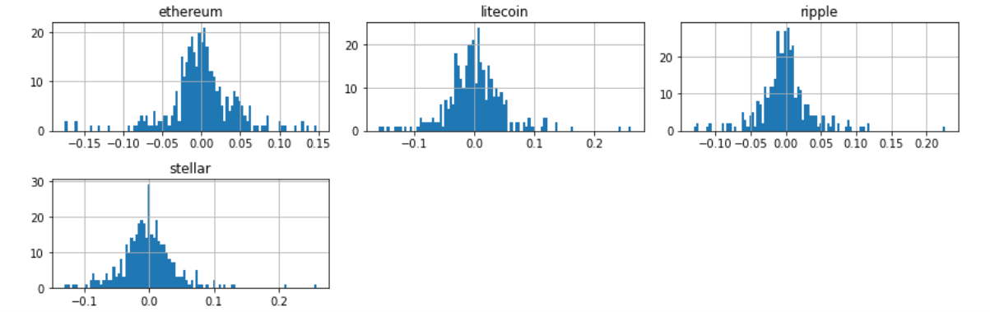
Applying Monte Carlo Simulation to optimize the portfolio

Slide 6
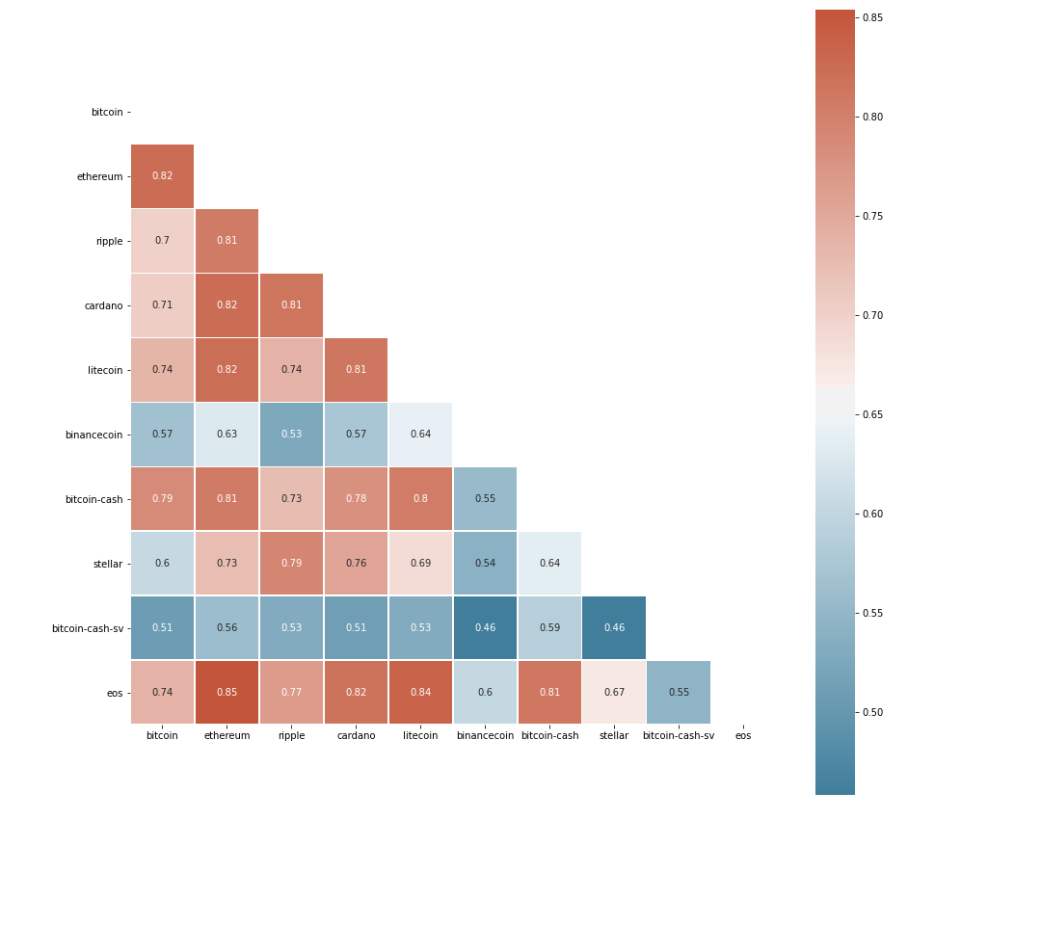
The majority coins are highly correlated to each other except Binance Coin and BSV.
Normally we should build the portfolio with lower correlated assets.

Slide 7
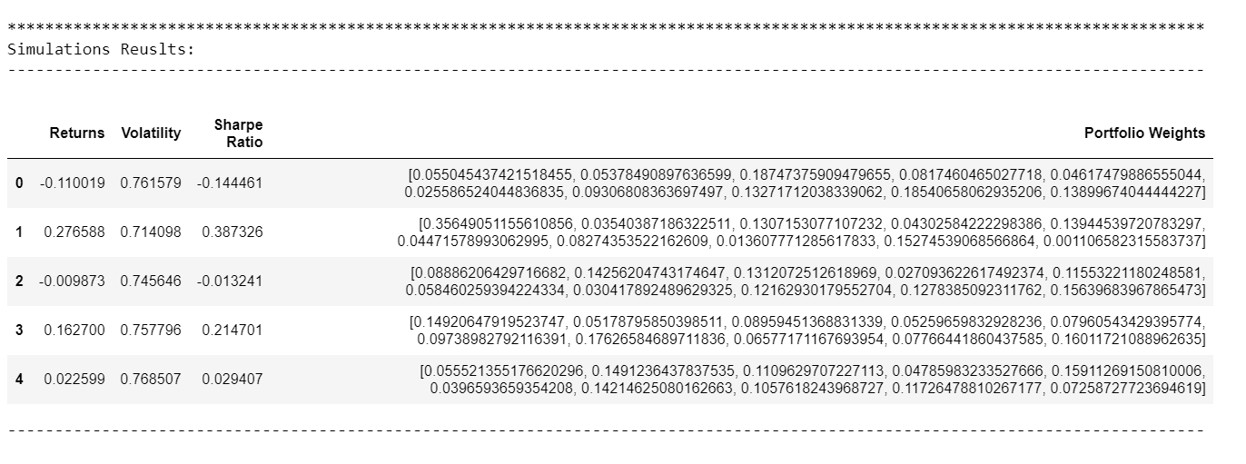
Simulation results : It ran 10.000 times and the results stored in an a dataframe

Slide 8
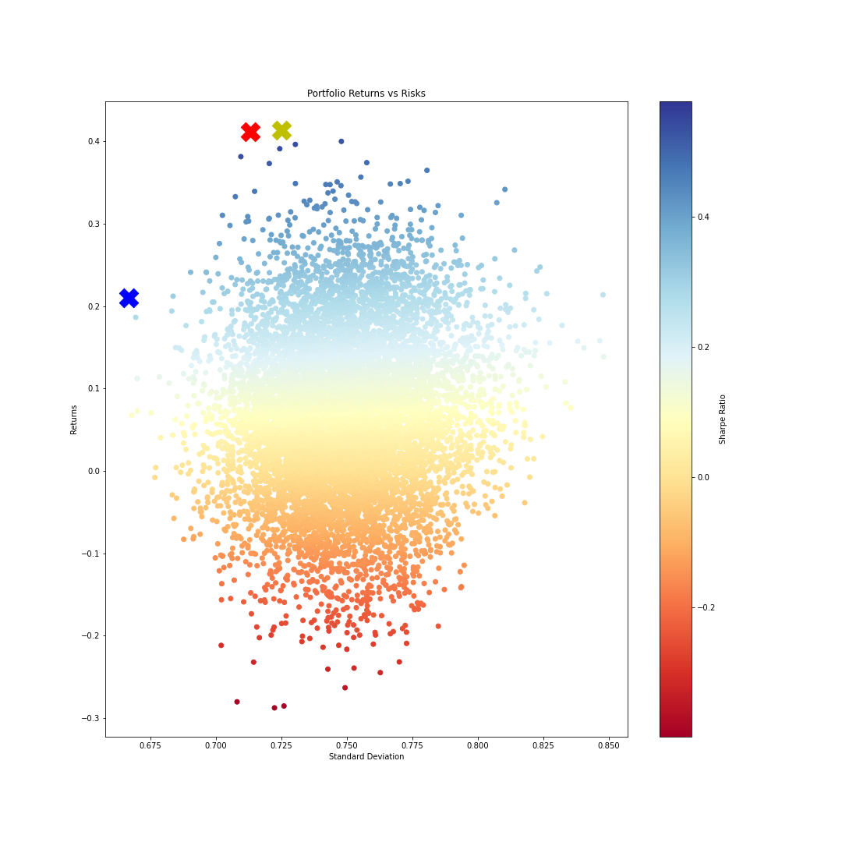
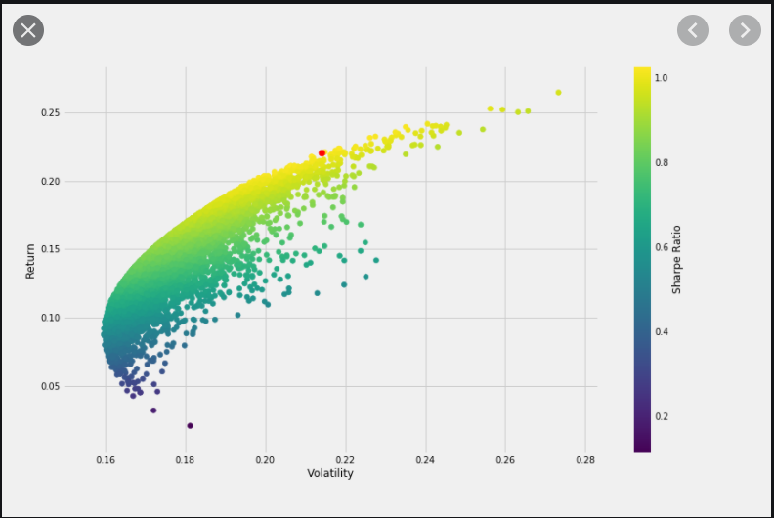
Plotting results x : highest sharpe ratio x : highest return x : lowest vol

Slide 9
Allocation of the fund
Coins | Max Sharpe Ratio | Max Returns | Min Volatility | Min Sharpe Ratio | Min Returns
BTC | 0.26 | 0.24 | 0.25 | 0.03 | 0.00
ETH | 0.04 | 0.00 | 0.05 | 0.08 | 0.11
XRP | 0.02 | 0.05 | 0.23 | 0.28 | 0.24
ADA | 0.03 | 0.10 | 0.08 | 0.04 | 0.24
LTC | 0.24 | 0.05 | 0.06 | 0.05 | 0.02
BNB | 0.24 | 0.27 | 0.22 | 0.01 | 0.08
BCH | 0.02 | 0.21 | 0.01 | 0.07 | 0.04
Stellar | 0.06 | 0.01 | 0.02 | 0.40 | 0.21
BSV | 0.06 | 0.03 | 0.08 | 0.04 | 0.03
EOS | 0.04 | 0.03 | 0.00 | 0.02 | 0.03

Slide 10
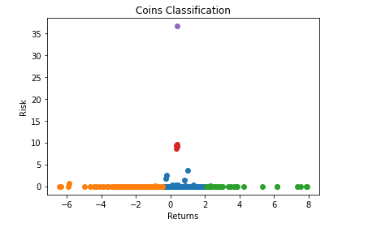
Classification with 1.883 different coins

Slide 11
Disclaimer
All the information in the ppt is no investment advice.
2. I personally think capital market is very brutal, just like a war. It follows generally 20:80 rule.
3. I am a believer in long term investment because I prefer to spend time to understand what I have invested in and what is the macro trend in the market.

Slide 12
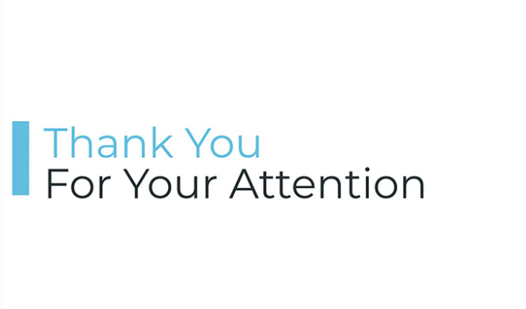
Any Question?

